Slide 1
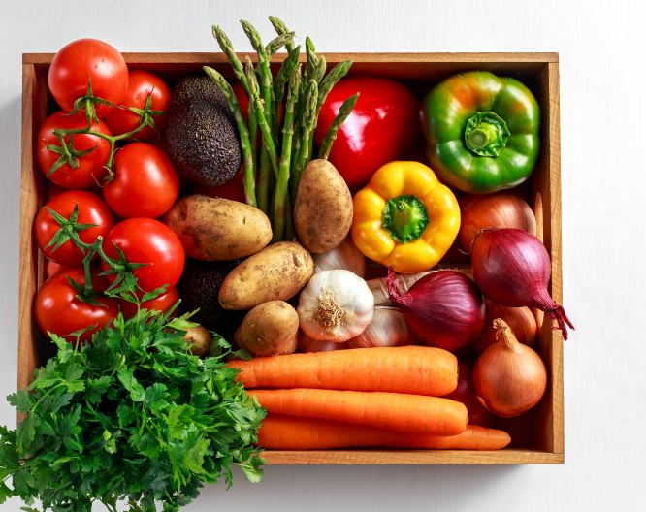
Gardening Club Quiz 21st July 21

Slide 2
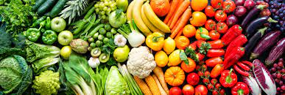
Do you know your vegetables?

Slide 3
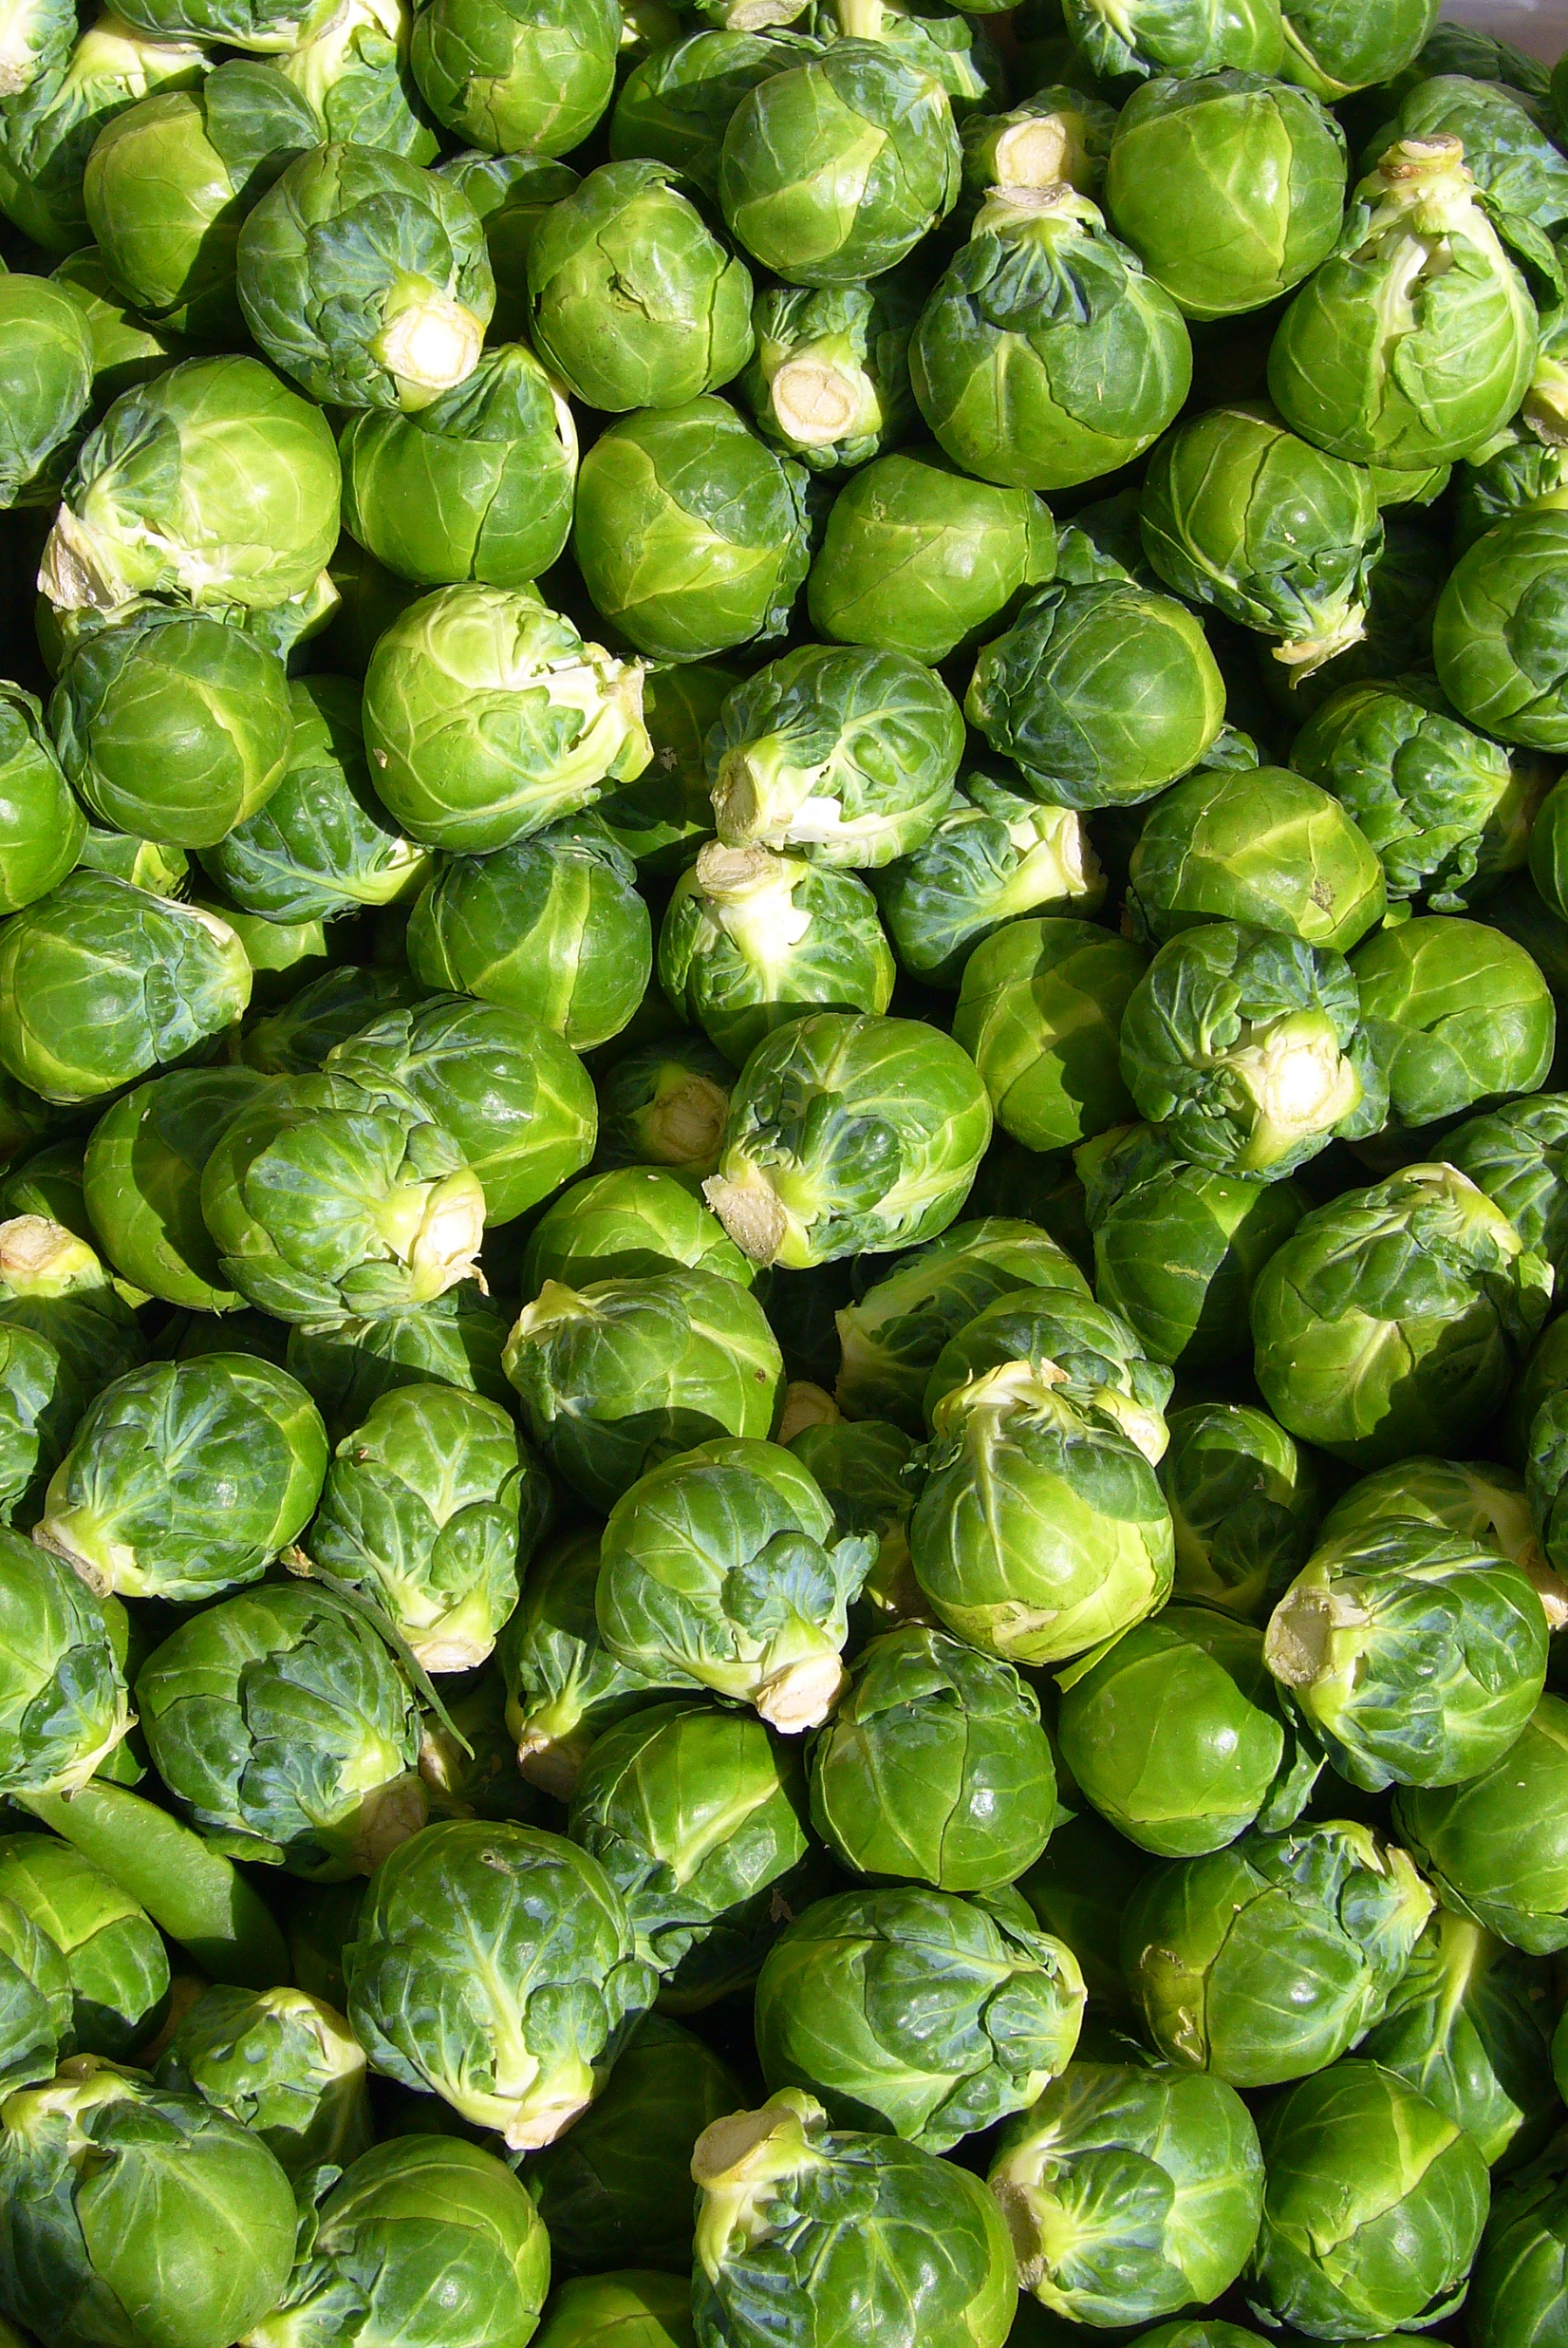
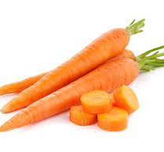
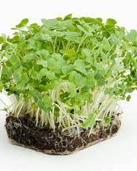
Which vegetable is NOT in season in Spring
1. Carrots
2. Watercress
3. Brussel sprouts

Slide 4
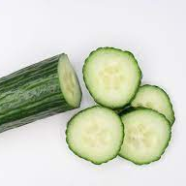
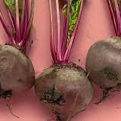
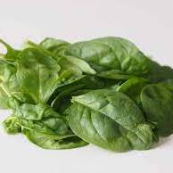
Which vegetable is not in season in the summer?

Slide 5
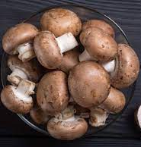
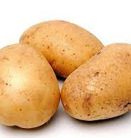
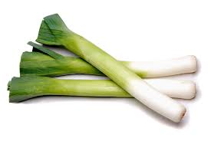
Which veg is not in season in Autumn

Slide 6
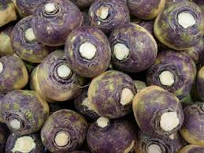
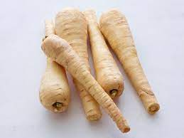
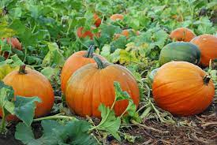
Which vegetable in not in season in Winter

Slide 7
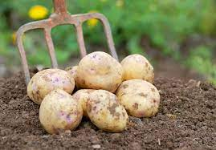
Where did the potato originated from?
Peru
Ireland
Spain

Slide 8
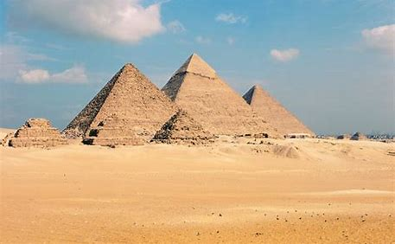
What vegetable was paid as wages to the ancient Egyptians labours who build the pyramids?

Slide 9

Which vegetable did the French refer to as the Apple of Love?

Slide 10
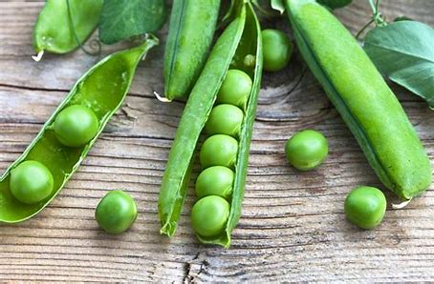
The world’s first sweet tasting pea was developed in the 18th century by amateur plant breeder Thomas Edward Knight of Downton, near Salisbury, England.
True or False

Slide 11
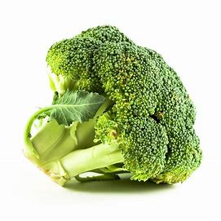
Which county produces the most broccoli in the world?

Slide 12
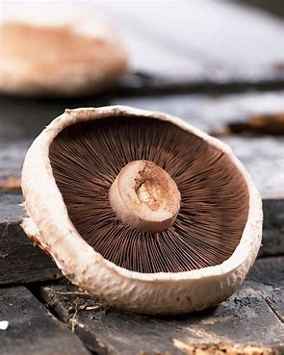
A single Portabella mushroom can contain more potassium than a banana.
True or False?

Slide 13
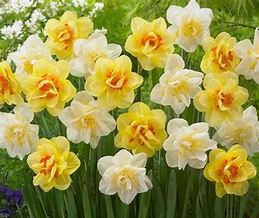
The Welsh national emblem is the daffodil and what vegetable?

Slide 14
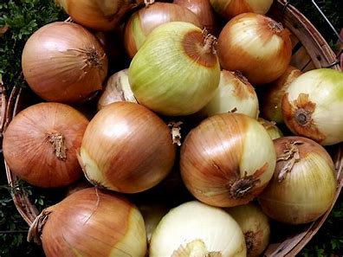
How many years have humans been growing onions?
A. 7,000
B 4,000
C 3,000

Slide 15
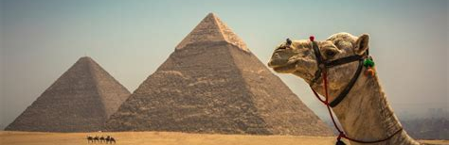
What Green vegetable was a symbol of fertility in Ancient Egypt

Slide 16

The Answers

Slide 17
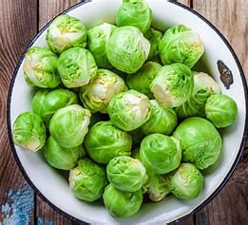
Question 1
Which vegetables are NOT in season in Spring
1. Carrots
2. Watercress
3. Brussel Sprout
Answer:
Brussel Sprouts they are in season in the winter

Slide 18
Question 2
Which vegetable is not in season in the summer
1. Beetroot
2 Cucumber
3 Spinach
Answer: Spinach is in season in the Spring

Slide 19
Question 3
Which vegetable is NOT in season in the autumn
Leeks
Potatoes
Mushrooms
Answer: Leeks they are in season in the winter

Slide 20
Question 4
What vegetable is NOT in season in the winter
1. Swede
2 Pumpkins
3 Parsnips
Answer pumpkins they are in season in the autumn

Slide 21
Answer 5
Where did the potato originated from?
Peru
Ireland
Spain
Answer: Peru they were domesticated between 3000 – 2000 BC

Slide 22
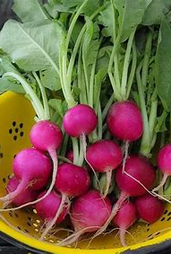
Question 6
Which vegetable was paid as wages to the Ancient Egyptians labours who built the pyramids?
Answer: Radishes

Slide 23
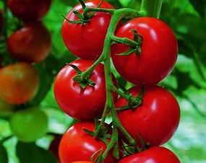
Question 7 which vegetable did the French refer to as the Apple of Love
Answer: Tomato

Slide 24
Question 8
The world's first sweet tasting pea was developed in the 18th century by the amateur plant breeder Thomas Edward Knight of Downtown near Salisbury England
True or False
Answer True

Slide 25
Question 9
Which countries produces the most broccoli in the world
Answer: China and India produce 73% of the worlds Broccoli

Slide 26
Question 10
A single portabella mushroom can contain more potassium than a banana
True or false
Answer: True

Slide 27
Question 11
The Welsh national Emblem is the Daffodil and what vegetable?
Answer: The Leek (legend of Welsh soldiers wearing the vegetable in their hats to differentiate their foes from the enemy)

Slide 28
Question 12
Question: How many years have humans been growing onions?
A. 7,000
B. 4,000
C. 3,000
Answer: 7,000 first found in Central Asia

Slide 29
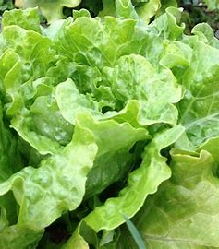
Question 13 What green vegetable is a symbol of fertility in Egypt?
Answer: Lettuce

Slide 30

The winner is:

