Slide 1

The Manager’s toolkit:
Covid-19 Vaccine

Slide 2
Purpose of the Managers Toolkit
The covid-19 vaccine programme is the largest vaccination programme the NHS has ever undertaken.
We want to ensure all care staff have easy access to the vaccine and accurate information to be able to make an informed decision
The vaccine doesn’t save lives on its own; it is through vaccinating large parts of the population
We know that employers supporting staff is a key factor in promoting uptake
Managers are key local leaders who have a key role to play and the toolkit aims to set out some guidance, examples and practical tips that will help you increase uptake

Slide 3
Key Information: Social care staff are a key priority group
  At this stage you should provide access to your staff that meet this definition:
  ‘frontline social care workers directly working with vulnerable people who need care and support irrespective of where they work ( example: those working in hospitals, clients own homes, day centres, or supported living/housing); or who they are employed by: local government, NHS, independent sector or third sector in face to face roles’.

Slide 4


Here are some examples of eligible roles…
  Privately employed carers (such as personal assistants), people who work in refuges, homeless services and housing support; carers; and ancillary staff (cooks, cleaners etc) that work directly in care services etc…
Staff that work only in an office, or supporting the general population (rather than vulnerable people) or that can work remotely (such as telephone advice) are not included and must not be given access at this stage. They will have the opportunity in the future.
If you are unsure of whether your staff are eligible then please ask for advice from
your local authority.

Slide 5
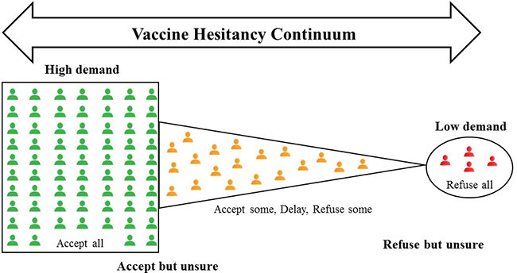
Vaccine take up
With all vaccines people have a range of views about whether they want to take it.
Typically there is a large group that accept all vaccines; a small group that refuse all vaccines and a fairly large group in the middle which are hesitant that have some questions.
Therefore, it is normal for some people to be hesitant and it is this group that need to have access to credible information to help them make an informed decision.
Managers are key to enabling this.

Slide 6
Why are people hesitant?
There are generally 3 core areas as to why people may not want the vaccine:
Perception about the safety or effectiveness of the vaccine.
Perception risk of covid is low (for you).
People are not contacted, do not know how to get the vaccine or perceive it to be difficult to get/not worth the effort.
It is important to understand people’s individual reasons for hesitancy and to address these sensitively. The following slides look at the 3 reasons detailed above and provide some information and advice about how you might address each.
Further support surrounding frequent questions and answers can be found on proud to care website to help support both you and your staff: Covid vaccine FAQ - Proud to Care (proudtocarenorthlondon.org.uk)

Slide 7
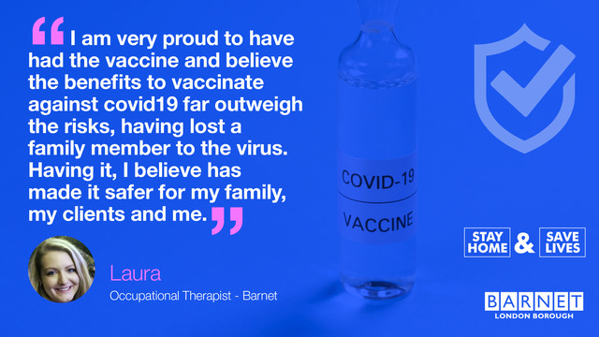
1. Perception about the safety or effectiveness of the vaccine.
Key Information: The vaccines are safe and effective
On 8th April 2021 over 750,000 people have had the vaccine in our 5 North London boroughs. This includes people from all ethnic backgrounds, social economic status and tens of thousands of care workers and NHS staff.
Please continue to share reputable sources of information (including the local authorities, information available from the NHS and London ADASS, Department of Heath and Social Care).
We continue update the frequently asked questions that we are hearing from care staff – please use these – if you get asked new questions then please tell us and we will work with GPs to answer them.
.

Slide 8
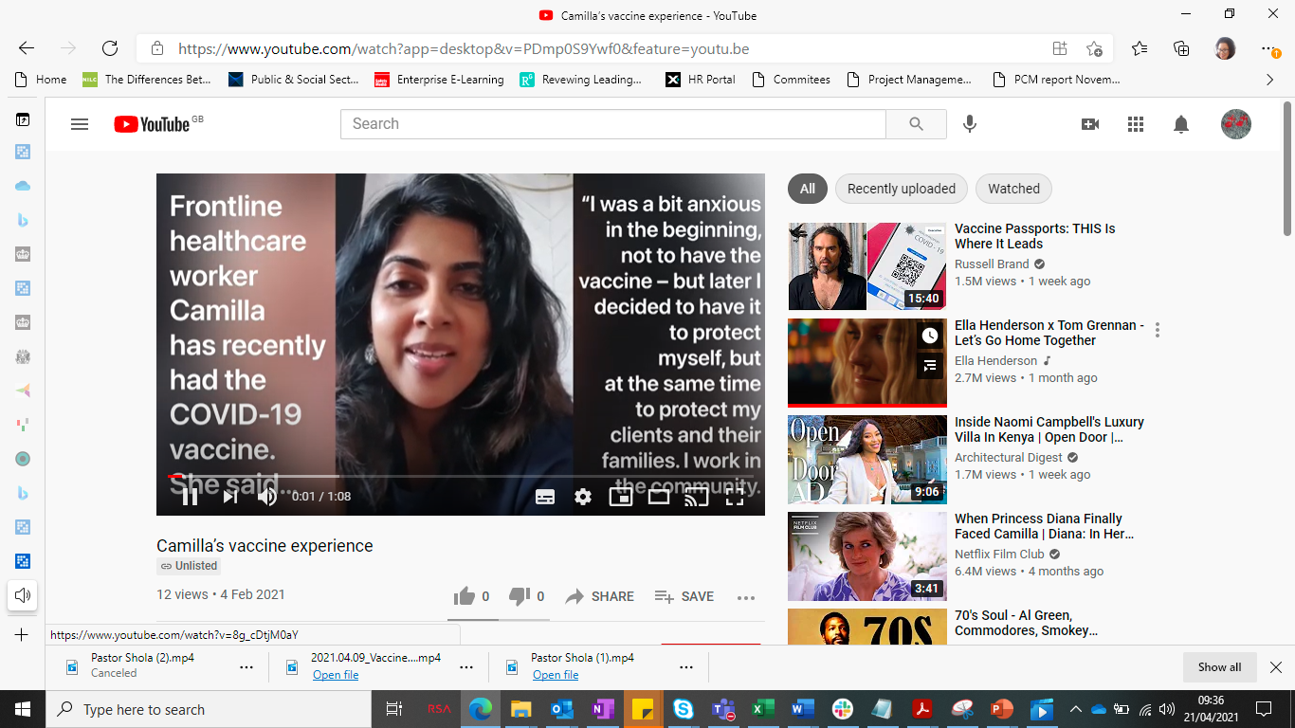
Case study 1: Frontline Staff Working in the London Borough of Barnet
Frontline healthcare worker Camilla has recently had the COVID-19 vaccine. She talks us through the process of how easy it is to get the jab when it’s your turn, to protect yourself from the threat of coronavirus. Vaccines are the most effective way of preventing people from getting serious infectious diseases – including coronavirus. Nothing goes into a vaccine unless it is absolutely needed.
Camilla’s vaccine experience - YouTube

Slide 9
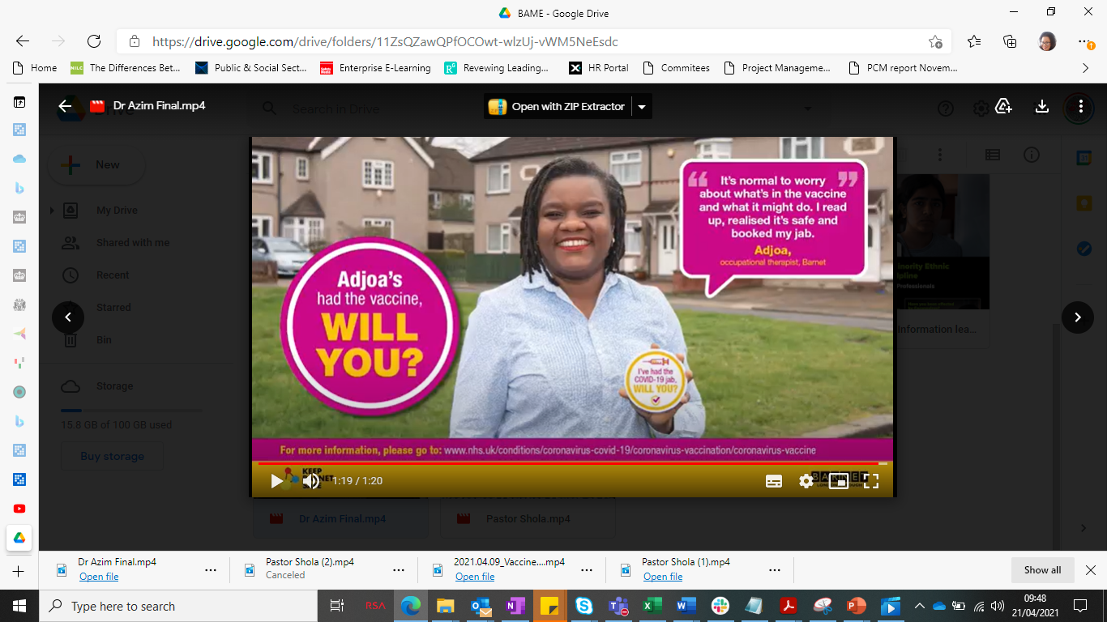
2. Perception risk of covid is low (for you).
Key Information: Covid-19 is a serious condition, and all care staff are safer once they have been vaccinated:
Those who work within social care are more likely to be exposed to covid-19 and (sadly) have higher rates of death from covid-19 than the general population.
People of Black, Asian and other Minority Ethnic origins are also generally at higher risk.
We are also finding that a small, but significant proportion of people have long covid (long terms symptoms) which can affect people of all age and fitness levels.
Some people have caught Covid-19 twice and we DO NOT know how long after contracting covid how long it will be before you are able to be reinfected.
There is increasing evidence that having the vaccine increases protection to your close contacts, such as family, friends and the people you care for.

Slide 10
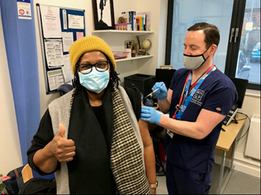
Haringey’s Director for Adults and Health Beverley Tarka discusses her personal experience with the COVID-19 vaccine, and urges everyone to get their vaccination when it is offered by the NHS, specifically those in Black, Asian and minority ethnic communities.
Case study 2: Ensuring the vaccine reaches all communities
Haringey’s Director for Adults and Health Beverley Tarka discusses her personal experience with the COVID-19 vaccine, and urges everyone to get their vaccination when it is offered by the NHS, especially those in Black, Asian and minority ethnic communities.
Beverley Tarka talks COVID-19 vaccine on Vimeo

Slide 11
3. Accessing the vaccine
Key information: Getting the vaccine in North London is easy:
All health and social care staff are eligible for the vaccine and book their appointment via the National Booking System or by calling 119.
  There are also a range of sites available for drop-ins, now including a range of pharmacies, for social care staff across the five boroughs which are advertised: https://northcentrallondonccg.nhs.uk/ncl-frontline-health-and-social-care-staff-covid-19-vaccination-registration/
Under 30’s
The Moderna vaccine is offered as an alternative to the AstraZeneca for all those under 30 accessing their first dose at the Islington Business Design Centre You can book this from this from the National Booking System, calling 119 or https://northcentrallondonccg.nhs.uk/ncl-frontline-health-and-social-care-staff-covid-19-vaccination-registration/

Slide 12
As managers can support with accessibility:
  Please be as flexible as possible in enabling staff to attend:
    you can pay staff for their time and expenses using the Infection Prevention and Control Fund (if you have this) or you can contact the Council if you need funding support
    Please confirm with staff you will pay their full wages in the unlikely event they need time off due to side effects
    Help staff to understand that getting the vaccine is simple and convenient and that they are a priority.
Booking staff in:
  Make laptops, tablets or phones available to staff to book in the office (e.g. after a staff meeting where you’ve discussed the vaccine) or share locations of drop ins
  It is possible to book on behalf of staff (with their consent) – this may be helpful for staff that don’t have access to a laptop or mobile phone or who are less confident with their English, for example.
At this stage we do not recommend seeking to make vaccination a condition of employment or for staff to feel forced – evidence says this tends to increase resistance to vaccination across staff groups

Slide 13
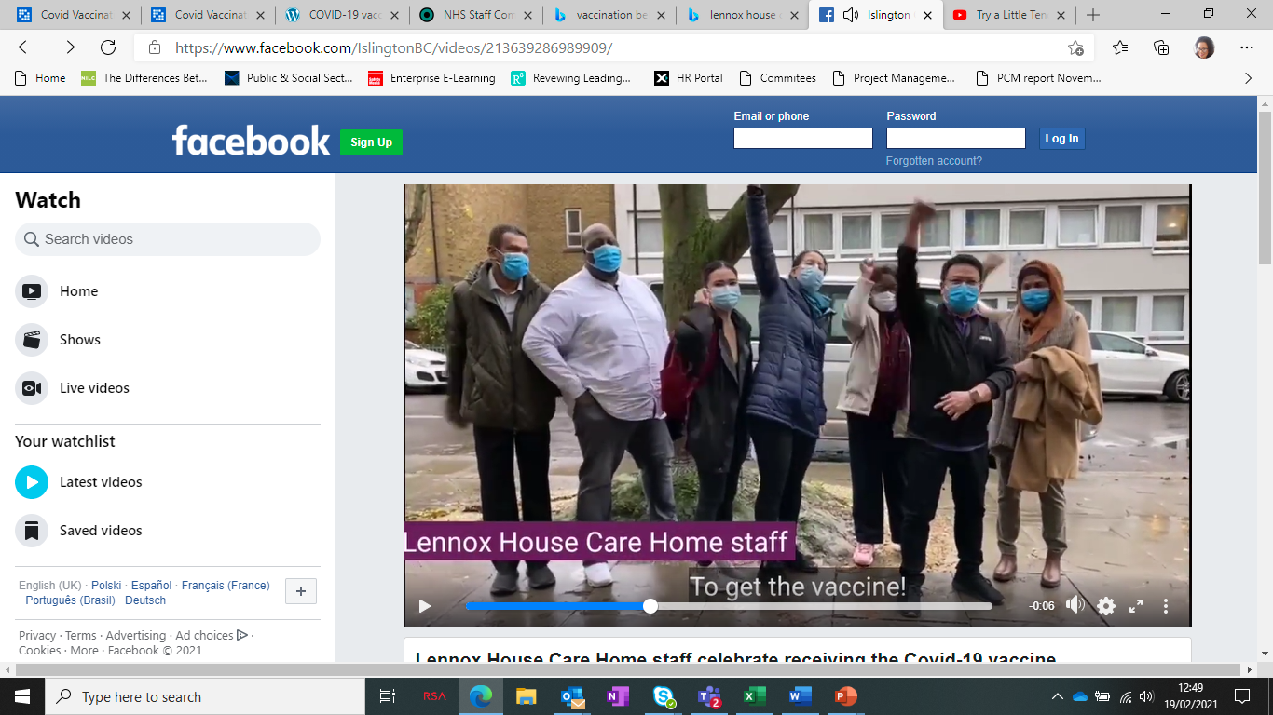
Case study 3: Good practice from one of our care homes
Lennox House: Critical Success Factors and Vaccination Strategy
Know your audience / staff
Own the campaign
Engage all stakeholders
Repetition & Consistency
Genuine empathy
Be available to listen
Multiple comms channels
Understand everyone is individuals
Generate and sustain momentum
Work with opinion formers
COVID awareness activities
80% of their staff consent to having the COVID Vaccination
5% of their staff unfit for vaccination
15% Vaccine remained hesitant
(Figures January 2021)
Islington Council - Lennox House Care Home staff celebrate receiving the Covid-19 vaccine | Facebook

Slide 14
As managers you can help by supporting access to creditable information and encouraging safe spaces to discuss the vaccine
Where staff have concerns it is important to take the time to listen respectfully, acknowledge the concern and provide information from credible sources to help them to make the right decisions for them.
Please talk to your staff about the vaccine – use group sessions; 1-1s; informal chats; Whatsapp groups etc.
Think about who the key influencers are within your staff group as they may be willing to help or become champions. Managers and key influencers having the vaccine can set an example for other staff.
Staff may take some time to change their mind whilst we want to vaccinate people as soon as possible, if people change their minds in future they will still have access
People often find seeing/hearing from people from their communities that are taking the vaccine (community champions, i.e. faith leaders etc) helps to give them confidence
Your LA can arrange group or even 1-1 conversations if this will help – tell us what you need!
Provide staff with the time to join webinars or to read the information we have provided online https://www.proudtocarenorthlondon.org.uk/covid-vaccination-faq

Slide 15
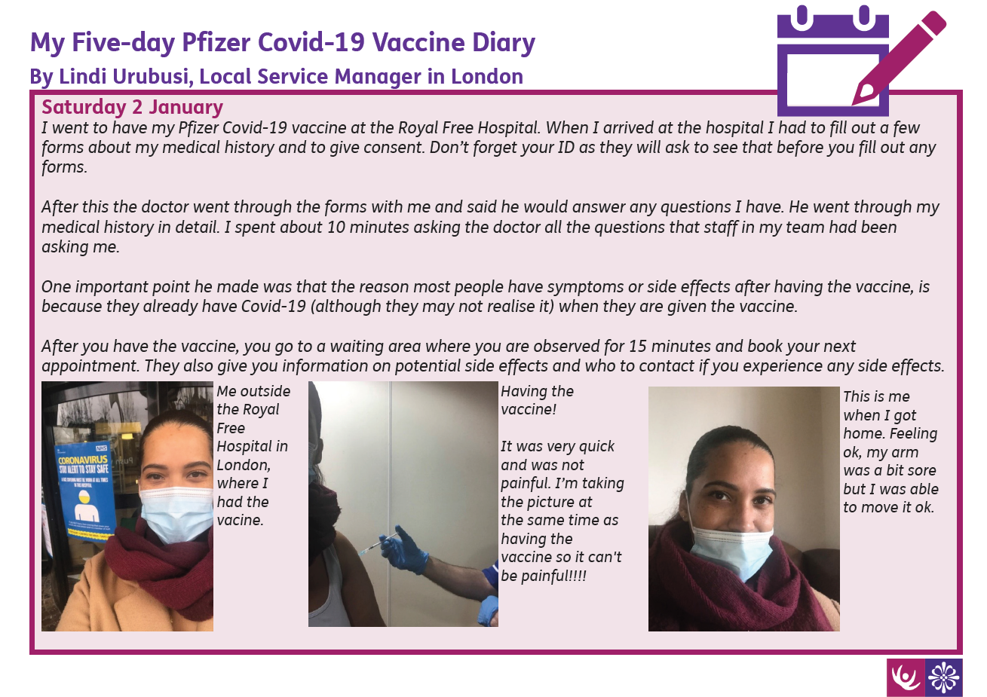
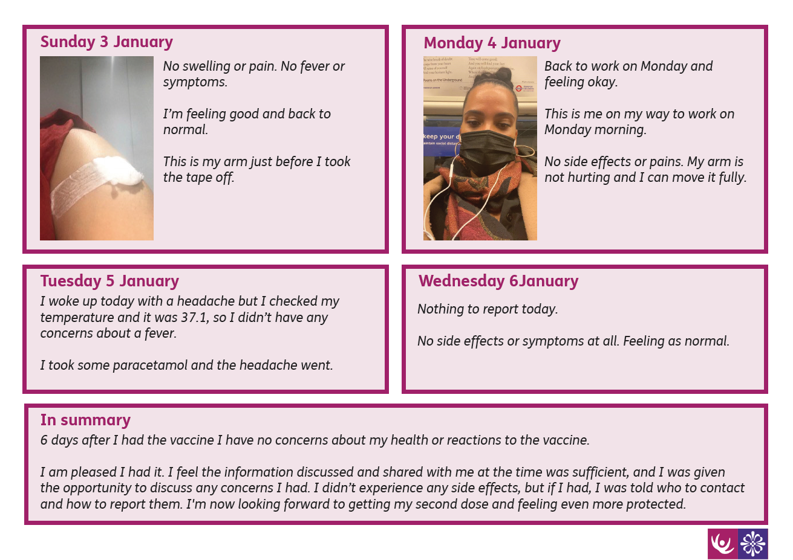
Case Study 4: Managers Leading by Example
We would love to feature photos or videos of you or staff having the vaccine
Tweet Us: @ProudtocareL or send them to ProudToCare@camden.gov.uk

Slide 16
Administration for Managers:
Create and keep staff lists that include direct, bank & agency staff
Record of all your staff who have been vaccinated (first and second dose)
Report overall staff uptake at least weekly as directed by your local authority: For example, for care home managers this will be on Capacity Tracker.
Remind Staff to take they are required to take one of the following:
a photographic ID badge to their appointment
a letter confirming their employment in the care sector
a payslip dated within the last three months
Note: No personal information relating to staff is required/requested by Councils.

Slide 17
Key contacts:
If you have questions about any aspect of the vaccination programme or support with resources please get in touch with your local Council lead
As examples, Councils have helped providers set up informal non-judgemental vaccination “coronachats” for groups of staff, whilst we’ve also supported staff that have concerns around health conditions to access 1-1 advice from a clinician,
We’d also love to hear from care providers about other examples of good practice that have helped increase uptake that we can share and celebrate.
Barnet | Camden | Enfield | Haringey | Islington
Carequality@barnet.gov.uk | socialcarevaccinationinfo@camden.gov.uk | Des.odonoguhe@enfield.gov.uk | Sujesh.Sundarraj@haringey.gov.uk | Russell.Jones@islington.gov.uk

Slide 18
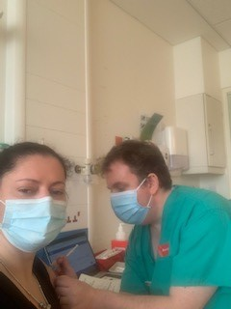
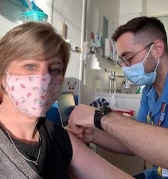
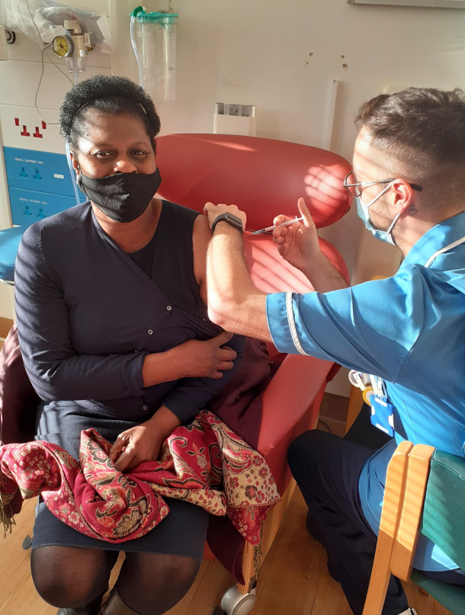
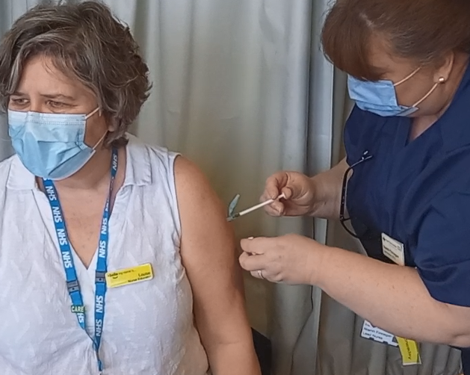
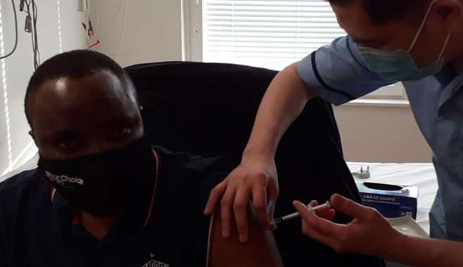
Staff In adult social care in NCL having the vaccine – more on https://www.proudtocarenorthlondon.org.uk/vaccinations-gallery

Slide 19
Additional Resources
Please see below a series of links to resources we consider maybe of value to you and your colleagues. If there are any additional credible resources, you wish to recommend for us to review/share please do not hesitate to contact us.
Letter to care homes: https://www.gov.uk/government/publications/covid-19-vaccinations-and-care-homes-programme-launch/covid-19-vaccinations-and-care-homes-programme-launch
PHE COVID-19 vaccination patient leaflet
Public Health England COVID-19 vaccine health and social care staff https://assets.publishing.service.gov.uk/government/uploads/system/uploads/attachment_data/file/951763/PHE_COVID-19_vaccination_guide_for_social_care_workers_English_v2.pdf
Leaflet what to expect after your COVID-19 Vaccinehttps://assets.publishing.service.gov.uk/government/uploads/system/uploads/attachment_data/file/951769/PHE_COVID- 19_vaccination_guide_what_to_expect_after_your_vaccination_English_v2.pdf

Slide 20
Resources
Pfizer vaccine patient information leaflet
https://www.healthpublications.gov.uk/ViewArticle.html?sp=Swhattoexpectaftermycovidvaccinationleaflet8pdla5
Leaflet what to expect after your COVID-19 Vaccinehttps://assets.publishing.service.gov.uk/government/uploads/system/uploads/attachment_data/file/951769/PHE_COVID- 19_vaccination_guide_what_to_expect_after_your_vaccination_English_v2.pdf
https://www.healthpublications.gov.uk/ViewArticle.html?sp=Swhattoexpectaftermycovidvaccinationleaflet8pdla5
Pfizer vaccine patient information leaflet
Consent forms and letters – residents with capacity, Power of Attorney and best interest decisions
General vaccine fact sheets, which can be downloaded here
Information covid-19 pregnancy and breast feeding https://www.gov.uk/government/publications/covid-19-vaccination-women-of-childbearing-age-currently-pregnant-planning-a-pregnancy-or-breastfeeding
https://www.rcog.org.uk

Slide 21
Resources
www.uktis.org
Download a zip file which has short videos (designed for social media) about the JVCI, what vaccines are, and the oxford vaccine here
Video about the Oxford vaccine can be viewed here
Video on how the vaccine was made so quickly
BMJ article regarding evidence for extending dose interval https://www.bmj.com/content/372/bmj.n18
Pregnancy and breast feeding https://www.rcog.org.uk www.uktis.org
Barnet Council – Covid Updates COVID-19 vaccine information | Barnet Council
Camden Council – Covid Updates Adult social care - Camden Council
Enfield Council – Covid Updates Guidance for Social Care and Residential Care settings (enfield.gov.uk)
Haringey Council – Covid Updates COVID-19: Latest news, help and support | Haringey Council
Islington Council – Covid Updates Covid vaccinations | Islington Council

