Slide 1
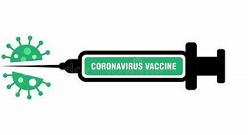
Covid-19 Vaccine

Slide 2
Contents:
Information about the Covid-19 vaccine
How to get the vaccine in north London for care staff
Resources and further reading on the Covid-19 vaccines

Slide 3
Vaccine take up
With all vaccines people have a range of views about whether they want to take it.
Typically there is a large group that accept all vaccines; a small group that refuse all and a fairly large group in the middle (sometimes called hesitant) that have some questions. Therefore, it is normal that some people will be hesitant and we want this group to have access to credible information to help them make an informed decision.
Key themes why people are hesitant:
Perception about the safety or effectiveness of the vaccine.
Perception risk of covid is low (for you).
People do not know how to get the vaccine or perceive it to be difficult to get/ not worth the effort
It is important to understand people’s individual reasons for hesitancy and to address these sensitively.

Slide 4
Is the vaccine safe for me to take?
In the UK we have several organisations that all ensure medicine and vaccines are safe to use. They are called:
Medicine and Healthcare products Regulatory Agency (MHRA)
Commission on Human Medicine
The Joint Committee on Vaccination and Immunisation (JCVI)
Currently the Pfizer/BioNTech, Oxford/AstraZenca and Moderna Covid-19 vaccines have been approved by the Medicines and Healthcare products Regulatory Agency (MHRA).

Slide 5
Medicine and Healthcare products Regulatory Agency (MHRA)
Their role is to ensure public safety regarding medicine and medical technologies. They regulate and authorise medicine before being available for public use.
The MHRA, started reviewing data on covid-19 vaccine since May 2020.
Safety and effectiveness
Clinical trials in humans
Manufacturing and quality controls
Product sampling
Testing of the final product
Lab results
The vaccines have been through 3 phases of clinical trials. As an example in the third phase Pfizer and AZ were given in total to more than 50,000 volunteers with no serious safety concerns.

Slide 6
How have the vaccines been produced so quickly?
Covid-19 is a worldwide public health crisis therefore we saw worldwide organisations come together to share unprecedented amounts of:
Resources
Funding
Collaboration
That is why we are seeing vaccine projects move at a much faster pace than we usually do.
You may find this video useful to explain how the vaccine trial moved so quickly:
https://www.youtube.com/watch?v=ddDiyIKUP0M

Slide 7
Why are social Care staff and residents getting vaccinated first?
The Joint Committee on Vaccination and Immunisation (JCVI), has recommended that the NHS offers these vaccines first to those at highest risk of catching the infection and of suffering serious complications if they catch the infection.
The current priorities include
All those aged 45 and over
Care workers and NHS staff
Clinically extremely vulnerable More info
People with underlying health conditions and unpaid carers
More info here: https://www.gov.uk/government/publications/priority-groups-for-coronavirus-covid-19-vaccination-advice-from-the-jcvi-30-december-2020

Slide 8
Why should I have the vaccine?
Having the vaccine offers immunity, to protect you from COVID-19. The more people that have the vaccine, the more it will help to protect those most vulnerable in our communities such as care home residents and family members.
Care Staff are at increased personal risk of getting COVID-19 due to their work.
There is increasing evidence that having the vaccine reduces the likelihood of
you passing the virus to others. We have started to see service users and
family members asking whether their care workers have been vaccinated and
we expect this number to grow.
By 8th April over 750,000 North Central London residents have had the
vaccine, many of which are frontline care staff. We are now well under way in second doses, including for frontline health and social care workers and care home residents.

Slide 9
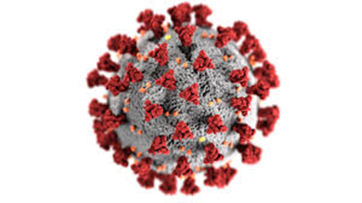
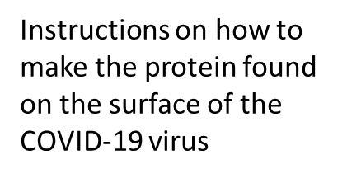
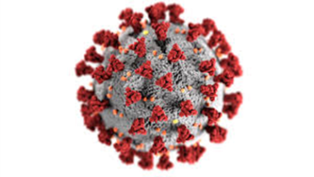
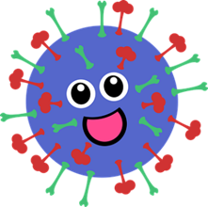
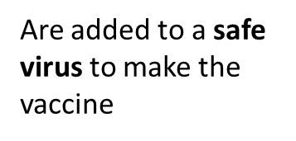
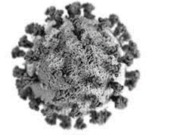
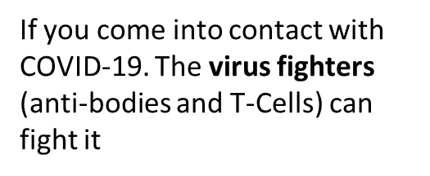
How are the vaccines made?
Oxford/AstraZeneca
Pfizer/BioNTech
The scientist takes part of the virus to make the vaccine. This part of the virus cannot give you COVID-19
Once injected the vaccine stimulates your immune system to produce virus fighters called anti-bodies and T-Cells

Slide 10
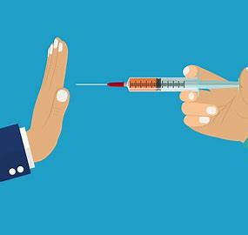
Do I have to have the Vaccine?
NO – you have the right to refuse
Vaccines are not mandatory in the UK
However we would encourage all staff to read information from creditable sources to make an informed decision

Slide 11
Will the vaccine give me covid-19?
NO – you cannot catch Covid-19 from the vaccines, It is not a live vaccine therefore you would not be injected with the live virus.
It is possible you may have caught Covid-19 before being vaccinated
(or shortly afterwards) and not realise it for a few days.
If you have symptoms of Covid-19 then you should
self isolate and get a test

Slide 12
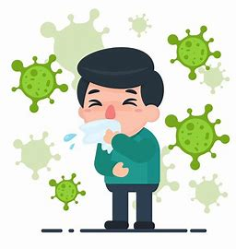
I have already had Covid-19, so do I still need the vaccine?
Experts do not know how long someone is protected from getting sick again after recovering from Covid-19.
Evidence suggests natural immunity may not last long so there is a risk of getting re- infected with Covid-19 again.
Therefore it is vital to have the vaccine even if you have already been infected with Covid-19

Slide 13
Truth about the vaccine
The VACCINE CONTAINS a mixture ingredients to list some: Sodium, Potassium, sucrose, cholesterol and magnesium most of these are found naturally in the body.
You may have seen some false information about the vaccine on the internet.
The below statements are truths about the vaccine
The Pfizer/BioNTech, Oxford/AstraZeneca and Moderna VACCINE DOES NOT contain: Blood products, egg or any animal products – the vaccines are therefore VEGAN
The vaccine does not contain microchips | The vaccine only has what it needs to produce the fighting cells and other ingredients to make it safe, able to be delivered and able to be stored. Nothing goes into a vaccine unless it is absolutely needed
The vaccine does not alter your DNA | The vaccine only gets you to produce an immune response – the virus fighters
The vaccine trials were not just in Africa | The Pfizer/BioNTech vaccine trials were in the United States, Europe, Turkey, South Africa, and South America. The Oxford/AstraZeneca vaccine trials were in the UK, Brazil and South Africa

Slide 14
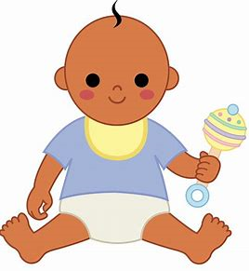
If you pregnant or planning for a baby should I have the vaccine?
The JCVI updated its advice on pregnant woman being vaccinated who are front line workers and or have underlying conditions that put them at higher risk, it is safe for them to have the vaccine.
The Royal College of Obstetricians and Gynaecologists (RCOG) agree with this recommendation. They are recommending having your vaccine through your maternity unit or notify them when it’s received.
Dr Edward Morris, President at the Royal College of Obstetricians and Gynaecologists, said: “We want to reassure women that there is no evidence to suggest that Covid-19 vaccines will affect fertility. Claims of any effect of Covid-19 vaccination on fertility are speculative and not supported by any data”.
RCOG states that Pregnant women that become unwell with covid may be at greater risk of becoming severely unwell, particularly in the 3rd trimester, and there is increased risk of premature birth.
Similarly there is no products in the vaccines or evidence of any sort that they impact male fertility

Slide 15
Who cannot have the vaccine?
The vaccines were found to be safe in people with various health conditions but there are a very small number of people cannot have the Pfizer/BioNTech and Oxford/AstraZeneca vaccine.
Those include those who have had:
a confirmed anaphylactic reaction to a previous dose of COVID-19 vaccine
a confirmed anaphylactic reaction to any components of the vaccine
Long Covid
Long Covid is not a sign that the patient should not receive the vaccine - but if they are symptoms are severe (i.e. unable to carry out daily activities), still under active investigation, or there is any evidence of recent deterioration the vaccination should be deferred to avoid any incorrect conclusion of any change to the persons underlying condition to the vaccine.
Where is a doubt as to whether you can receive the vaccine please speak to your GP/HCP for more information

Slide 16
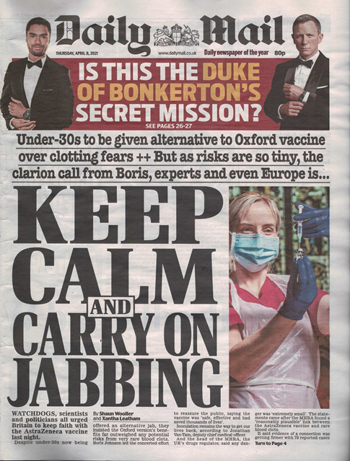
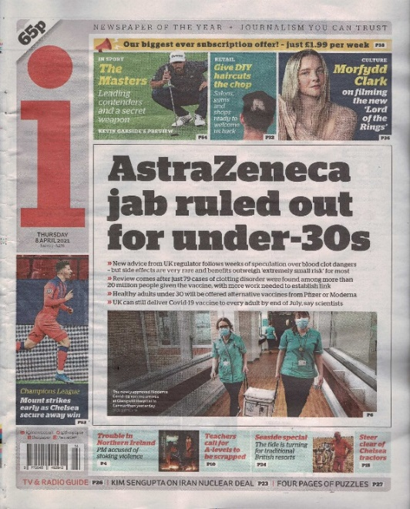
COVID-19 vaccines and clotting abnormalities
People who contract the COVID-19 disease have a high risk of developing problems with blood clotting
About a fifth (1/5) of people hospitalised with COVID have evidence of blood clots
This can have a serious effect, even fatal, if in the lungs (pulmonary embolus) or in the brain
These also occur without COVID Blood clots are also commoner:
after surgery
after long periods of immobility
in those taking oral contraceptives
after long haul flights

Slide 17
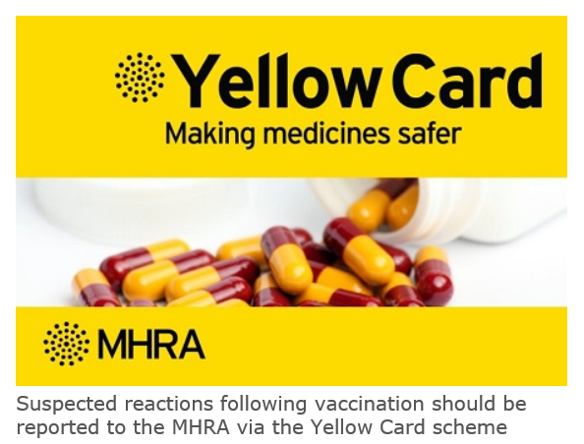
COVID-19 vaccines and clotting abnormalities
Via the yellow card system there were reports of a rare
form of clotting problems after receiving the Oxford AZ vaccine
This is not like most forms of clotting “and not known to be a common feature of COVID-19 infection”
In this case there are blood clots with low levels of platelets (these are present in blood and stop us bleeding)
This form of clotting can happen after treatment with heparin, but often no cause is found.

Slide 18
MHRA Announcement: 8th April 2021
20.2 million doses of Oxford AZ COVID – 19 vaccine had been given
79 people developed thrombosis with low platelets.
Of whom, 44 had a clot in a vein in the head (cerebral venous sinus thrombosis – CVST)
Of the 79 people, 19 have sadly died
It seems commoner in younger people, which is the group at least risk of complications of COVID-19 disease
All occurred after the first dose, usually within 28 days

Slide 19
What are the risks?
Overall, the risk of death from one of these rare blood clots after the AZ vaccine is about 1 in million
Guessing a four digit PIN code on first attempt – 100 in a million
Picking five winning numbers in the National Lottery – 7 in a million
Dying after being stung by a bee – 15 in a million
Being struck by lightning – slightly less than I in a million
Scoring a strike with every ball during a game of ten-pin bowling – 87 in a million
Figures from Mail on Sunday 11th April 2021

Slide 20
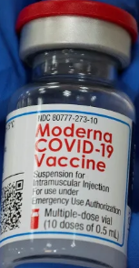
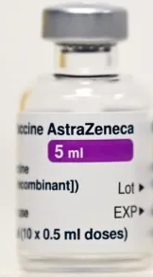
The new advice from JCVI
The AZ vaccine should continue to be offered to all those in phase 1, i.e. over 50, or those in a high risk group.
The only exception would be the rare instance of someone who had this reaction to their first dose. They should have an alternative vaccine
All those in phase 2, who have already had the first dose of AZ including under 30 will continue to be offered AZ vaccine for their second dose
Those under 30, who have not had their first dose of COVID vaccine should be offered an alternative to AZ vaccine

Slide 21
Clotting and other COVID-19 vaccines
Clotting disorders have not reported after Pfizer and Moderna vaccines.
The EMA announced on Friday it was investigating reports of clots among four people who had received the Johnson and Johnson vaccine, one of whom had died.
With the Johnson and Johnson vaccine it is too early to say if the four reports are connected but we do know it uses similar technology to AZ vaccine.

Slide 22
Covid-19 vaccine and people prescribed Blood thinners
Individuals receiving direct oral anticoagulants (Apixaban, Rivaroxaban) or warfarin can all receive the COVID-19 vaccination.
Although people on warfarin with supra-therapeutic INR should wait until their INR is <4.0.
People with inherited bleeding disorders such as Haemophilia need to seek advice from their own Haemophilia Centre to ensure they receive the vaccine safely.
What to expect after vaccination
There is an increased risk of bruising at the injection site but no anticipated and serious effects related to anticoagulation

Slide 23
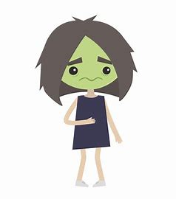
Possible Side effects
Like all medications and vaccines, the Covid-19 vaccines can cause side effects – although not everyone will get them.
Most side effects are mild or moderate and go within a few days of appearing, they can be treated with medicine for pain and fever such as paracetamol.
Very common side effects:
Pain and heavy feeling at the injection in the arm you had your injection. This tends to be worst around 1-2 days after the vaccine
Tiredness
Headache
General aches
Mild flu like symptoms/feverish

Slide 24
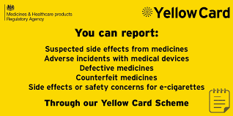
Possible side effects
Less common side effects may effect up to 1 in 100 people
Enlarged lymph nodes
A high temperature is also unusual and may indicate you have COVID-19 or another infection.
There is a coronavirus yellow card reporting site
https://coronavirus-yellowcard.mhra.gov.uk where health professionals and people that have had the vaccine can report any side effects.

Slide 25
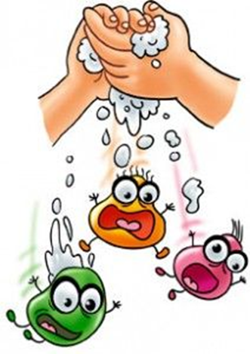
Whilst the vaccine will make us safer…
The vaccine is just one tool in our tool box to prevent COVID-19.
No vaccine is 100% effective
We do not know how long protection will last
We do not yet know how effective the vaccine is at stopping spread of the disease
You have all worked incredibly hard to prevent outbreaks and to protect your staff and residents so we want to emphasise this point.
The need to:
Continue to wear PPE
Continue with testing
Continue to follow infection prevention control guidance
Continue to follow the guidance if anyone has any symptoms of Covid
Coronavirus (COVID-19): adult social care guidance - GOV.UK (www.gov.uk)
Coronavirus (COVID-19): adult social care guidance - GOV.UK (www.gov.uk)
25

Slide 26
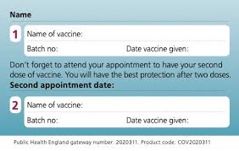
You will receive a covid-19 vaccination card after your first dose which is important for you to keep in a safe place as its helpful to take to your next appointment. You can use this for personal use to tell others you have had the vaccine. However these details are recorded in your NHS records. This is not a “Covid passport”.
Covid-19 vaccine appointment

Slide 27
Frequent Questions and Answers
Yearly vaccines
Is yearly vaccination necessary? At this stage we do not know the answer to that question. Like the ‘flu virus, the Covid-19 virus does mutate. So, just as is needed for ‘flu, we may need to give boosters of the Covid-19 vaccine.
Travel
Will vaccine status be required for overseas travel? It is already necessary to have Yellow Fever vaccine to travel to some countries. It is looking likely that this will be the case for Covid-19 vaccine. Ideally this will be decided by countries, or groups of countries, rather than individual airlines.
Vaccine manufacturers and NHS staff
Why do Pfizer and Oxford need protection from legal action If the vaccine is safe? Every company and majority of people need to have insurance and legal protection ranging from those who administer the vaccines to the manufacturers. Having legal protection is not a reflection on the efficacy or safety of the vaccine.
Are clinicians being paid by vaccine companies or vested interests to vaccinate people? No. NHS staff are being paid for their time to vaccinate people as part of their usual NHS contracts. None of the regulatory bodies that have approved the vaccine are being paid by vaccine companies or other vested interests.

Slide 28
Why is there now a 12-week gap between my vaccine appointments?
One major reason for the change in approach is to protect the greatest number of at-risk people overall in the shortest possible time. Therefore, maximizing the number of eligible people who received the vaccine during the critical winter period. At 2-3 weeks after the first dose of the Pfizer vaccine 89% of people are protected; at 3 weeks after the first dose of the Oxford vaccine 73% of people are protected.
We also know from the trials of the AZ vaccine that a longer gap between doses gives better protection. This is what is seen with vaccines against other diseases that generally a longer gap between vaccine doses leads to a better immune response. The immune system remembers the first dose and will respond whether the later dose is 3 weeks or 3 months.
Young people
Do younger adults need to have the vaccination as Covid-19 is less serious for them?
Whilst Covid-19 is more serious on average for older people it can still be very serious and at times fatal for younger people. We are also finding people of all ages and levels of fitness can be impacted by long term effects of covid-19 (long covid). As well as your personal health having the vaccine also helps reduce the risk to others.

Slide 29
Who is a social care worker?
Frontline social care workers directly working with vulnerable people who need care and support irrespective of where they work (for example in hospital, people’s own homes, day centres, or supported housing, homelessness services etc); or who they are employed by (for example local government, NHS, independent sector or third sector).
This is a wide definition – the key is that the service supports vulnerable people and is delivered face to face. The local authority is responsible for id’ing services.
If you have questions about whether you or colleagues are eligible please contact your Local Authority lead:

Slide 30
Roll out of the vaccine in North London
There are a range of delivery models:
Hospital sites
Primary Care
Pharmacies
Large public sites
Roving model to care homes and housebound residents

Slide 31
Process to register
Frontline social care workers 45 and over can book directly www.nhs.uk/covid-vaccination or by calling 119 (this will offer a range of sites for appointments)
There are sites available for drop ins for health and care workers of all ages, which are advertised here https://northcentrallondonccg.nhs.uk/ncl-frontline-health-and-social-care-staff-covid-19-vaccination-registration/ This includes options for those under 30 who are not recommended to have the Oxford / AZ vaccine.
When you go to your appointment you need to show you work in care with a photo ID card or a letter from your employer or a payslip from the last 3 months. We suggest you also take a pen and your NHS number.
*Staff will be asked for their NHS number as this makes the process much quicker. Although, if they do not have this information they WILL still be able to access the vaccination. More information on how to access your NHS number is on the Proud to Care North London FAQ’s page*

Slide 32
What we ask of registered managers:
Keep a record of all your staff vaccination status, including agency – with your staff’s consent.
Provide each staff member ensure have ONE of the following:
letter confirming their employment in the care sector
a photographic ID badge
payslip from the last 3 months
Report uptake fortnightly as directed by your local authority – (for care home managers: Capacity Tracker)
Councils will ask you for the proportion of your staff that have been vaccinated - but they will never ask you specific personal/sensitive information which can be used to identify staff.
Consider the logistics of releasing staff to receive their vaccine, while maintaining safe staffing levels within the service
Where possible staff can access the vaccine during their paid hours or in their own time. Councils support funding for some staff so please ask if this is a barrier.

Slide 33
Managers Toolkit
Managers may want to book on for the vaccine to set an example as leaders in the sector.
We would love to feature photos or videos of you or staff having the vaccine – please tweet them to us: @ProudtocareL or send them to ProudToCare@camden.gov.uk
Please contact your council lead if there are things that we can support you with that would help increase uptake in your staff – as we have a number of free services available to support managers and staff.
We can only achieve our aims through working together.

Slide 34
Further resources
A map of current sites available to book on the national booking system https://www.google.com/maps/d/edit?mid=1D-r3EbpiHnUKOq5Vo7I1n3BdxpVsCZdF&usp=sharing
Letter to care homes: https://www.gov.uk/government/publications/covid-19-vaccinations-and-care-homes-programme-launch/covid-19-vaccinations-and-care-homes-programme-launch
PHE COVID-19 vaccination patient leaflet
Public Health England COVID-19 vaccine health and social care staff https://assets.publishing.service.gov.uk/government/uploads/system/uploads/attachment_data/file/951763/PHE_COVID-19_vaccination_guide_for_social_care_workers_English_v2.pdf
Leaflet what to expect after your COVID-19 Vaccinehttps://assets.publishing.service.gov.uk/government/uploads/system/uploads/attachment_data/file/951769/PHE_COVID- 19_vaccination_guide_what_to_expect_after_your_vaccination_English_v2.pdf
https://www.healthpublications.gov.uk/ViewArticle.html?sp=Swhattoexpectaftermycovidvaccinationleaflet8pdla5
Pfizer vaccine patient information leaflet
Consent forms and letters – residents with capacity, Power of Attorney and best interest decisions
General vaccine fact sheets, which can be downloaded here
Information covid-19 pregnancy and breast feeding https://www.gov.uk/government/publications/covid-19-vaccination-women-of-childbearing-age-currently-pregnant-planning-a-pregnancy-or-breastfeeding
https://www.rcog.org.uk
www.uktis.org
Download a zip file which has short videos (designed for social media) about the JVCI, what vaccines are, and the oxford vaccine here
Video about the Oxford vaccine can be viewed here
Video on how the vaccine was made so quickly
BMJ article regarding evidence for extending dose interval https://www.bmj.com/content/372/bmj.n18
Pregnancy and breast feeding https://www.rcog.org.uk www.uktis.org

Slide 35
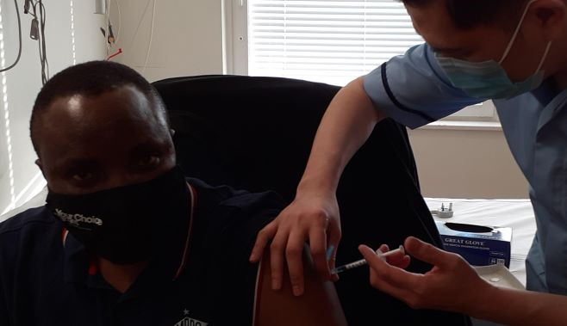
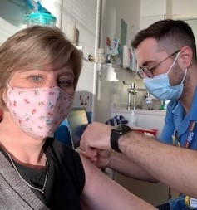
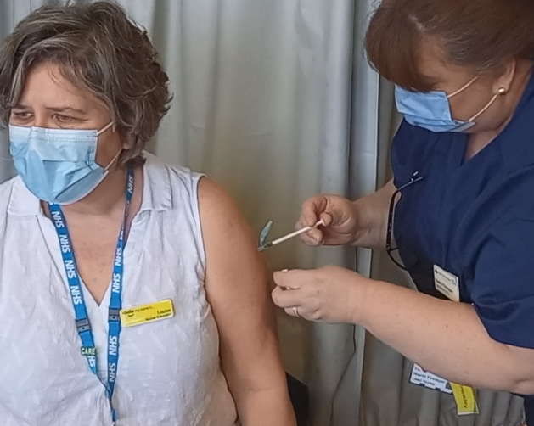
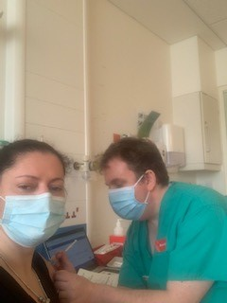
Images of our NCL colleagues within adult social care having the vaccine
Email: proudtocare@camden.gov.uk for LIVE Webinar & FAQ Session for Social Care Staff

