Slide 1

ePEP training
Monday 31st January 2022
Mary Holder, Samuel Denham, Lynn Burrows, Leonie Holt
Education Consultants
Camden Virtual School
Notes:
LEONIE:
Introduce other consultants

Slide 2

Starter Activity
Please write down or put in the chat the most important thing you wish to get out of today’s training.
Notes:
Leonie:
At the end of the session there will be a chance to look back and ensure the goals you have set for the session has been met

Slide 3

Aims
To introduce or familiarize you with the ePEP system.
To understand the purpose of the different sections
To identify who completes each section and the timescale for completion
To highlight the most frequent areas of difficulty and how to maximize the potential of these areas.
Notes:
LYNN

Slide 4

The Personal Education Plan (PEP)
The PEP is a statutory requirement for all Looked After Children between the ages of 3-17 years old. It describes the strengths, needs and aspirations of a Looked After Child and identifies the best ways of maximizing the education provision in order to support them in achieving their goals. The aim for the PEP is to provide a record of continuity of education, progress and attainment as the journey takes them through school transitions.
The network of professionals within the meeting – school, social worker, carers – will be able to use their knowledge and expertise to formulate the most effective plan, with the young person’s voice heard throughout.
The PEP is also the gateway to applying for Pupil
Premium Plus funding, for students of statutory school age.
Notes:
LYNN

Slide 5

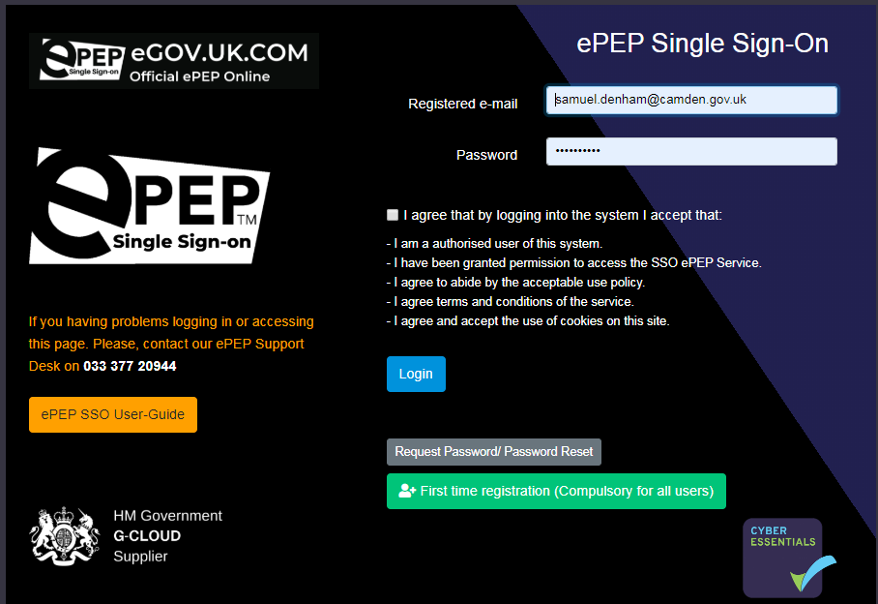
A Quick Intro
https://secure.epeponline.co.uk/login
Log in details are sent through from the Virtual School.
If you have any problems with you log in
Notes:
SAM to do:

Slide 6
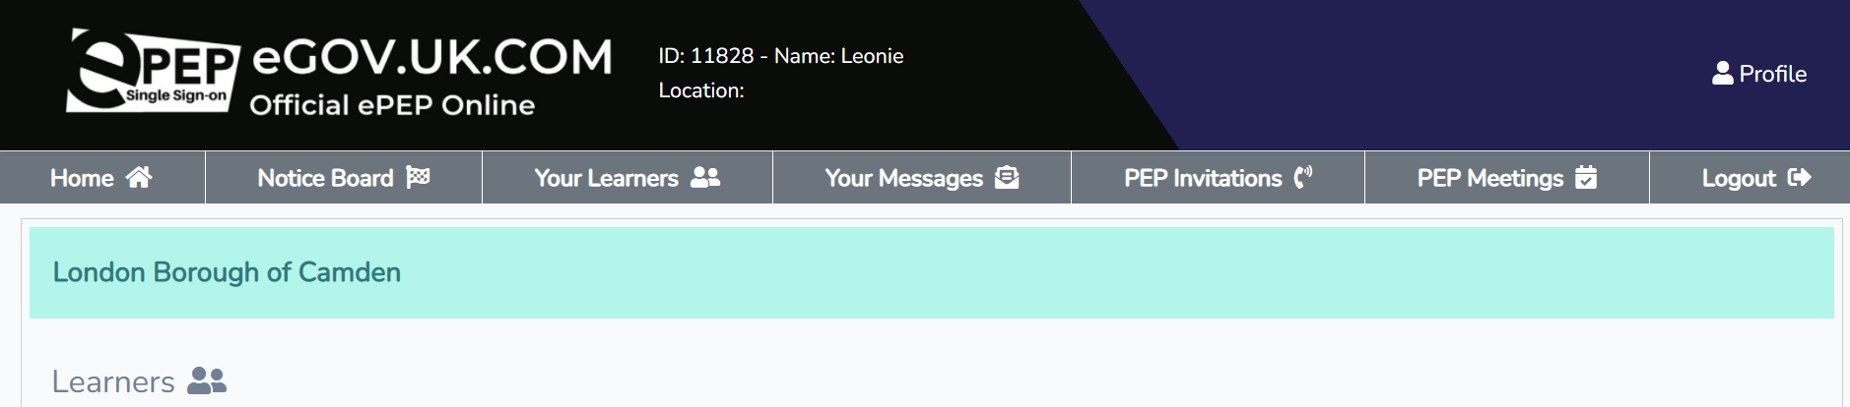
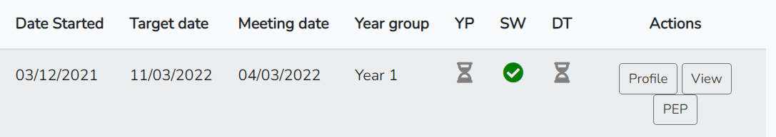
The ePEP platform
This is where you can access the young person’s profile and their current PEP.
The ticks and timers let you know who has already completed their sections.
Notes:
SAM
Notes: you can see the PEP meeting date and target date for completion which is a week later. These are the 3 sections of the PEP: SW, DT, YP

Slide 7
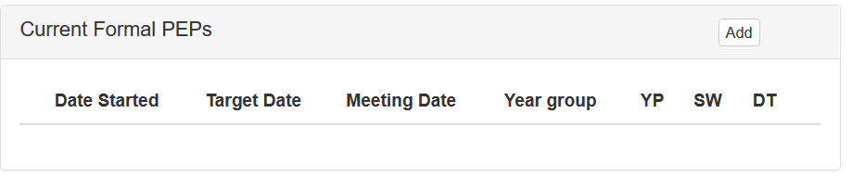
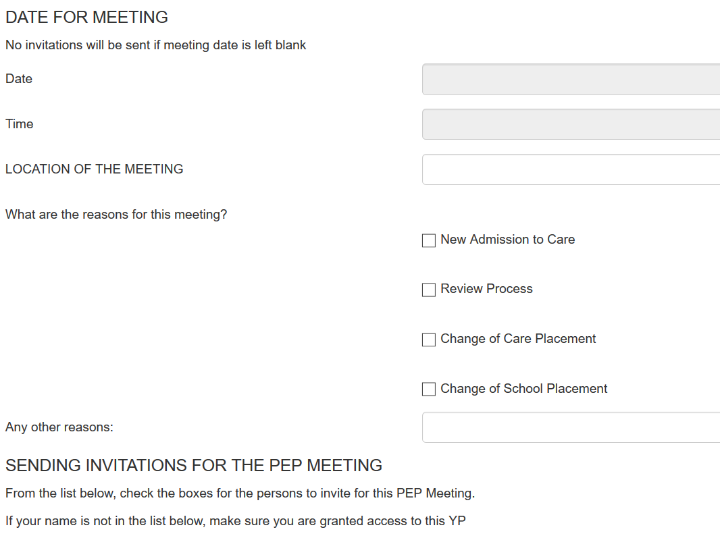
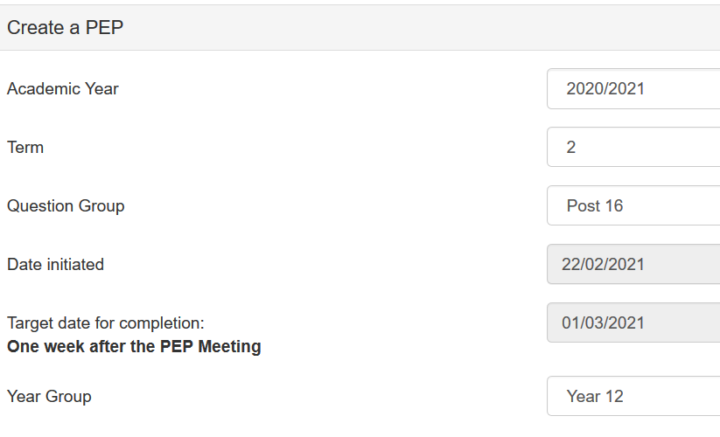
Initiating a new PEP – Young person’s Profile Page – Scroll Down…
Notes:
Leonie-
Statutory Guidance states that the PEP should be held not later XX days after coming into care

Slide 8
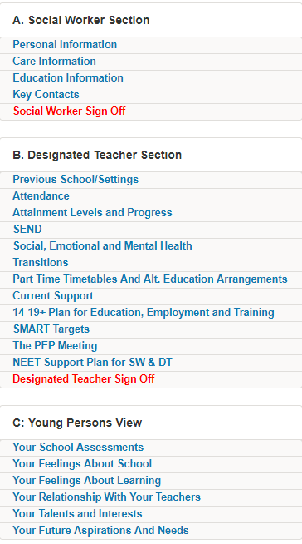
How the PEP is divided
This is all aspects of the care that are important to the child’s education. This is the easiest way of a school finding out about their child.
These are all of the aspects of a child’s education provision. Breaking them down into these sections allows all strengths, needs and support to be easily identified.
This section is designed to ensure the child’s voice is heard throughout the PEP.
The more detailed their replies the more they can affect their education.
Notes:
Leonie_

Slide 9







The care section – key points
Activity:
1 If there is an issue with homework/coursework
A
2. School’s may not understand the terms of FCO, SGO, Section 20. Explaining it here if the parents should be informed, or the social worker allows for effective practise.
B
3. Knowing this date will allow a school to understand the history of the child. Important when considering if the support needed is to deal with new or old trauma.
C
D
4. If punctuality or absences is an issue, this could be a simple explanation.
E
5. Looked After Children are very vulnerable to change and need support whenever there is a transition.
F
6. If the school know when possible traumatic events could happen – such as a missed contact – they can support their welfare.
G
7. A quick simple check to ensure the safeguarding of the child.
Notes:
SAM-

Slide 10
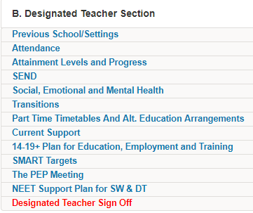
The School section
A quick summary:
Help with understanding or identifying long-standing issues
Well-being check. Form tutor or class teacher would be best placed as they see the child every day.
In PEPs for KS4/post 16 aged students - early identification of strengths, ambitions, pathways means additional support and opportunities can be found.
Notes:
Lynn-

Slide 11
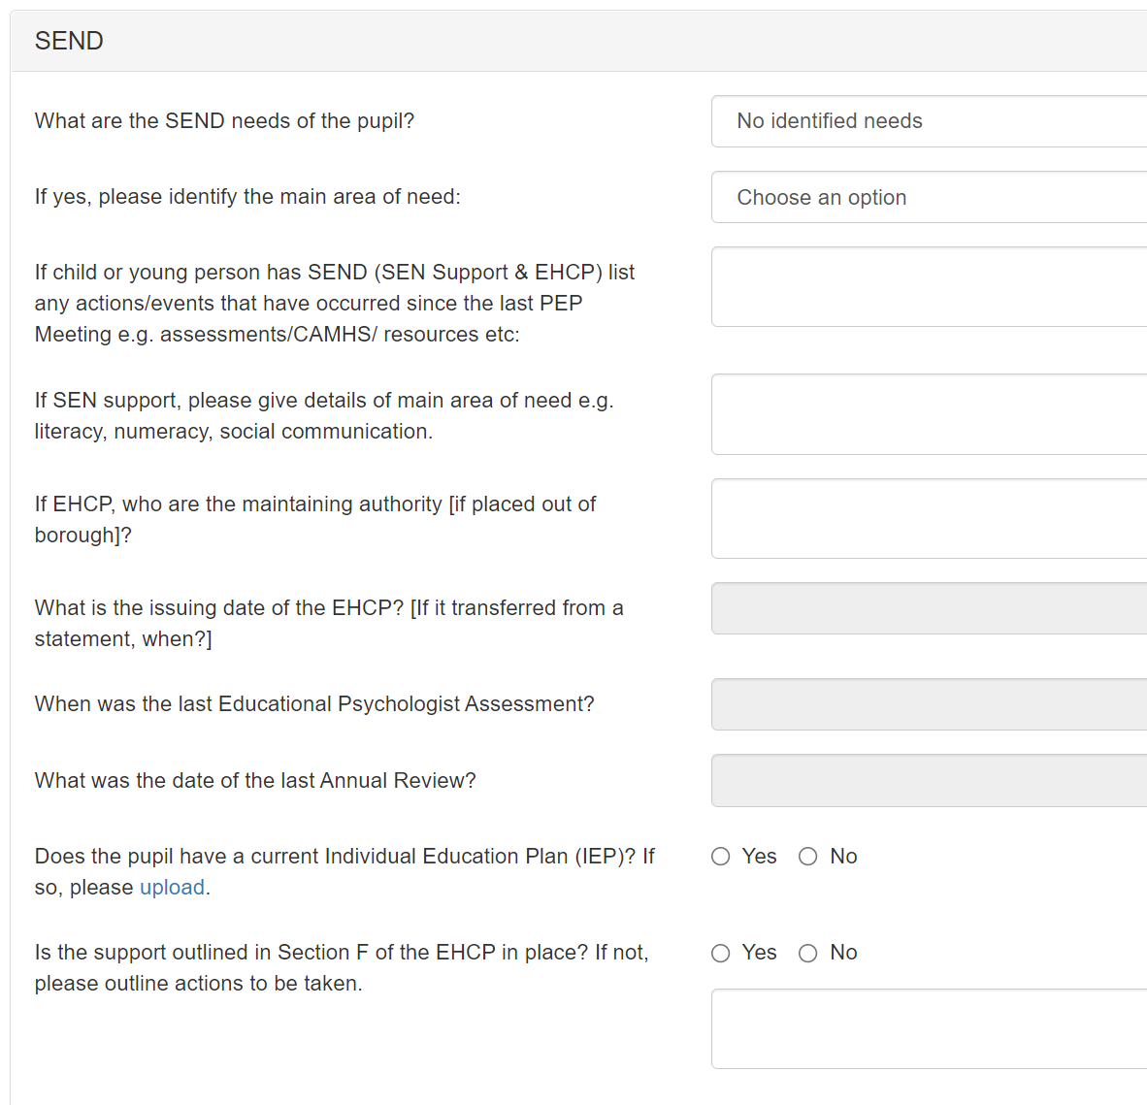
SEND
To be completed by the school SENCO if the CYP has an Education Health Care Plan (EHCP) or is receiving additional support for any identified SEND (SEN Support : Code K).
This allows all parties to know when Annual Reviews are (which should be scheduled at the same time as the PEP), when the last EP reports took place and what the main area of need is.
If there are no additional needs, then just click.
Notes:
LYNN-Children in care are nine times more likely to be identified as having special educational needs than their peers.
The Department for Education estimate that around 70% of looked after children have a special educational need compared with 20%
of the general school population.
Many looked after children and previously looked after children face additional barriers to learning because of their early childhood
experiences. They may have complex social, emotional and psychological issues, including the impact of trauma and attachment
difficulties. They may also have experienced periods of school absence or frequent changes
of school.
SEN Support is a category of support for pupils with SEN (outlined in the SEND Code of
Practice) where the school puts in place SEN provision that is ‘additional to or different from’
the provision made generally for pupils of the same age. Schools may refer to SEN Support
as Code K.
Dfe good practice guidance- For CYP with an EHC Plan should have a combined EHCP Review/PEP once a year-this avoids extra work and duplication as there is an overlap of key information
Please upload the IEP/ISP and any reports made since the last PEP e.g. EP, S&LT, to ePEP Documents

Slide 12
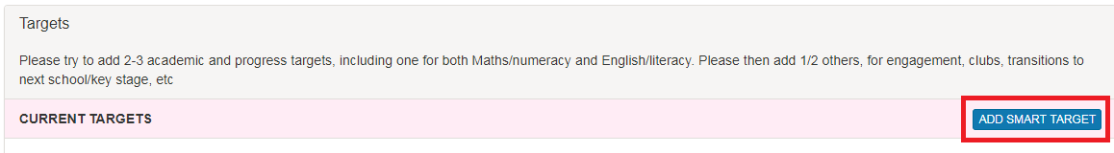
SMART target
Activity: Which of these are the best targets and why?
To try to achieve a 3+ in English Language in their next school report.
To improve their use of spelling and grammar within their English Language lesson.
To confidently recall number bonds to 10 by the end of the autumn term
To stay focused and engaged throughout their English Language lesson.
To ensure that they do all of their homework.
Notes:
Lynn
Leonie to briefly talk about primary targets as well as targets on the slide

Slide 13
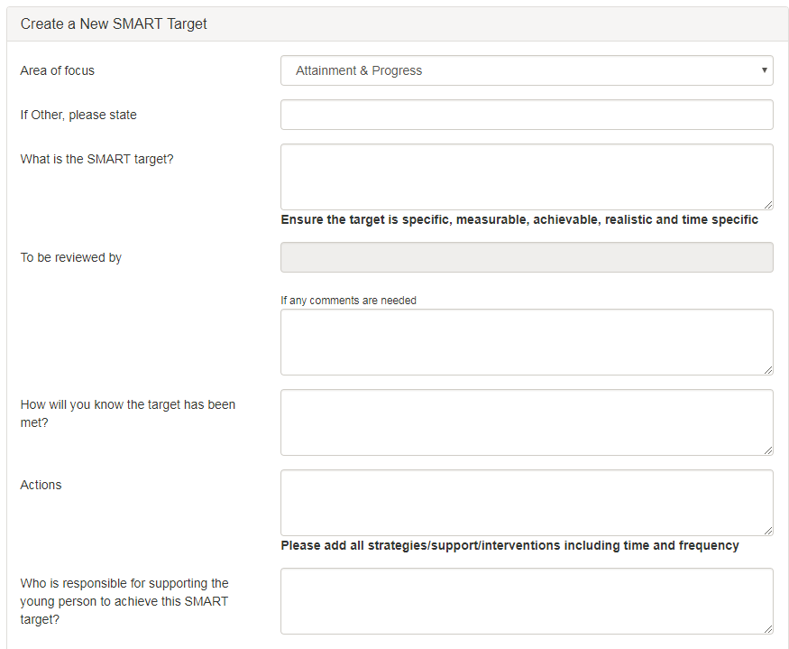
SMART target
Specific
Measureable
Achievable/Attainable
Realistic/Relevant
Time bound
Note: The actions should identify what support others can provide. Not what the child can or should do
Notes:
Lynn

Slide 14
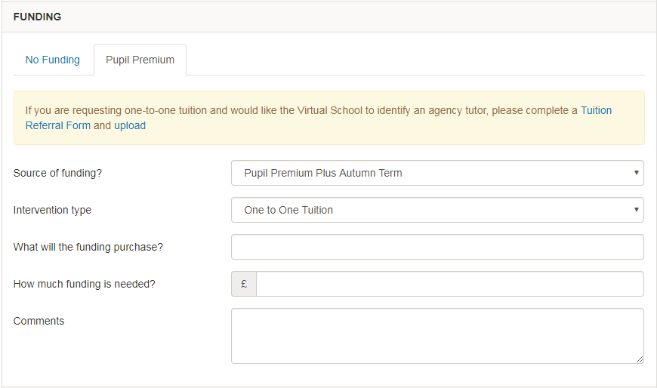
Pupil Premium Plus funding
If one of the actions for the SMART target needs funding. This can be applied for beneath.
For any funding request specific details are required:-
Description
Cost
Frequency
Impact
Evaluation.
For secondary aged students, the most common request it to receive tuition. This can be sourced by the Virtual School and take place at their home, school or a local public space. A referral form for additional information is found here and – once completed and saved – is uploaded here.
Intervention types
1:1 tuition / small group support
mentoring / coaching
therapeutic / specialist support
alternative education
extra curricular activities
pupil incentives
digital technology
education resources
Notes:
LEONIE-

Slide 15
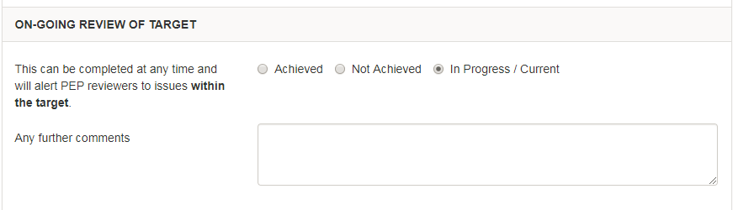
In the next PEP…..
At the bottom of each target is the evaluation. In the next PEP you identify if it was achieved or not and comment.
Note, you cannot apply for further funding on this target. If you wish for additional funding to achieve the target then you need to evaluate this as not achieved and begin a new target.
Notes:
LEONIE- very important to review the targets at next PEP
If CYP are not making progress over time the target should be modified-broken down/changed
Targets should not remain beyond an academic year

Slide 16
All of these sections should be completed before the PEP meeting starts.
Notes:
LEONIE

Slide 17
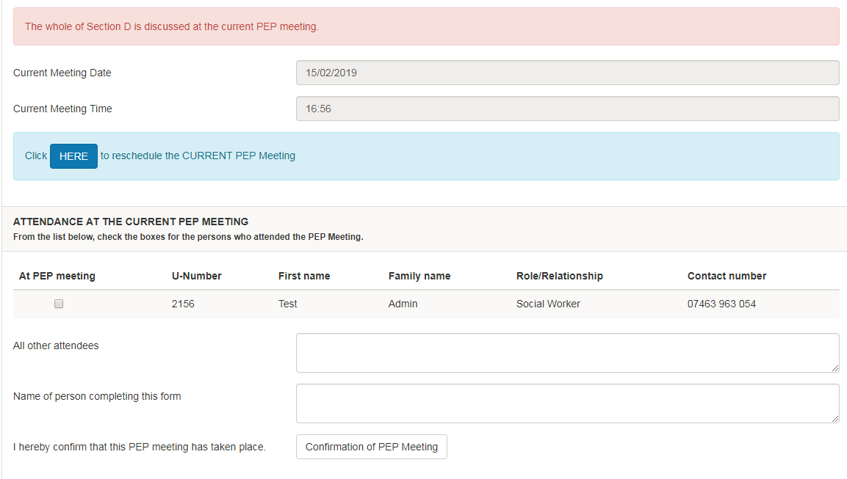
The PEP meeting
This is the official record of the PEP.
A PEP can only happen with a social worker present.
If the young person decides not to attend, then their views can be added through an advocate or through Section C.
A record of what is discussed is recorded here.
Notes:
MARY

Slide 18
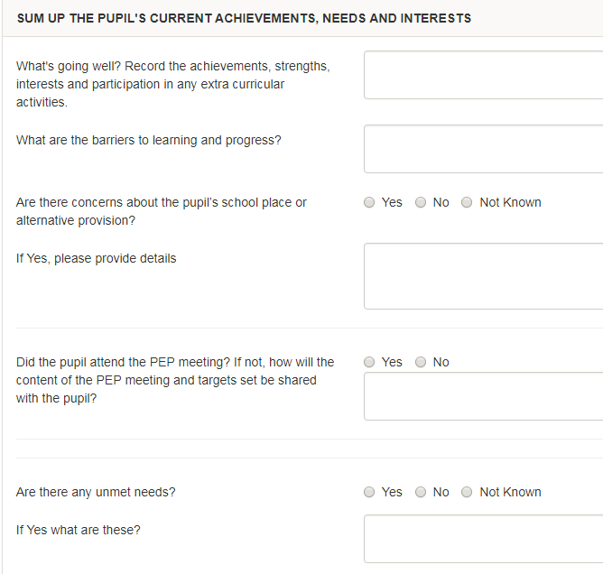
Strengths and needs
This is educational – not care issues.
A round robin from teachers is best practise.
Achievements, strong performances in certain subjects, excellent work, extra curricular activities, improvements are what we are after.
Barriers – weaknesses, subjects, areas of SEN, confidence, self esteem.
Notes:
MARY

Slide 19
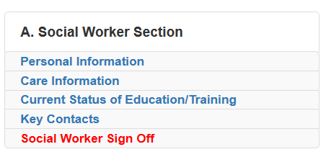
Post 16 ePEP completion
Social workers and Personal Advisors are required to complete the following sections on the left, in full.
Notes:
MARY

Slide 20
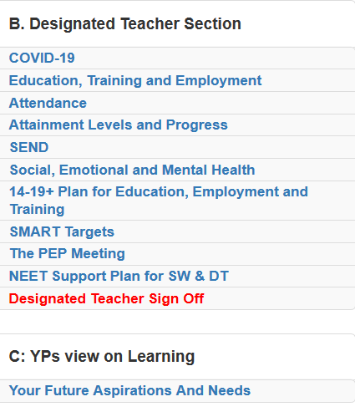
Post 16 NEET PEP
Social workers and Personal Advisors are required to complete the following sections contained in the red boxes on the left, in full.
Notes:
MARY

Slide 21
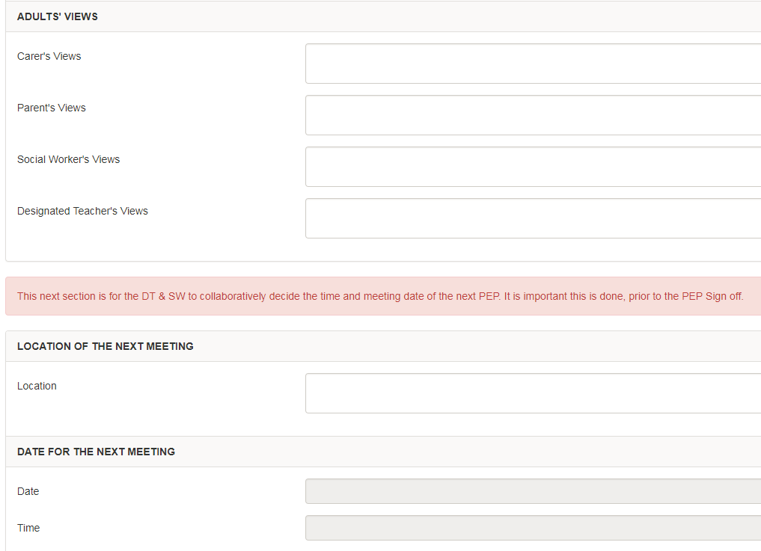
Views
These are positive paragraphs that summarize views and encourage and bring confidence to a child when they read/hear it.
Notes:
MARY

Slide 22
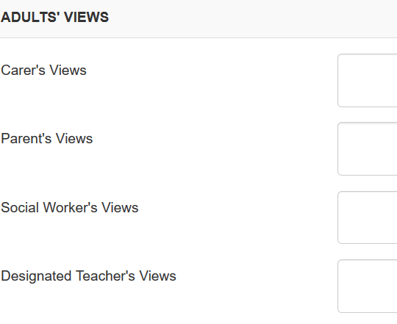
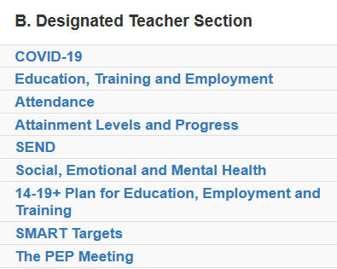
Social Worker/Personal Advisor view
Social Workers and Personal Advisor’s are required to ensure their views are record in Section B, The PEP Meeting.
Notes:
MARY

Slide 23
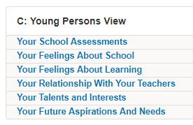
Young person’s views
It is easiest for the school to sit down with the young person and let them complete this.
The information allows them to input their view into the plan.
For younger children, school staff will record this on behalf of the child.
Completing this section ensure the voice of the young person is captured but also helps targeted intervention from the school/college/Virtual School.
Notes:
SAM

Slide 24
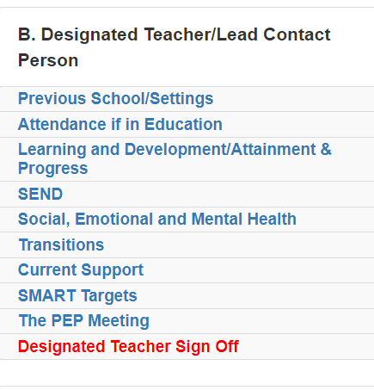
Early Years PEP
Early years includes birth – 5.
PEPs completed for children aged 3-5 years.
Sections of the Early Years PEP aligned to PEP with exception of attainment and progress and child views:
Progress is recorded in 7 areas of learning and development
Child view questions have been amended but an organic conversation works best.
Notes:
LEONIE

Slide 25
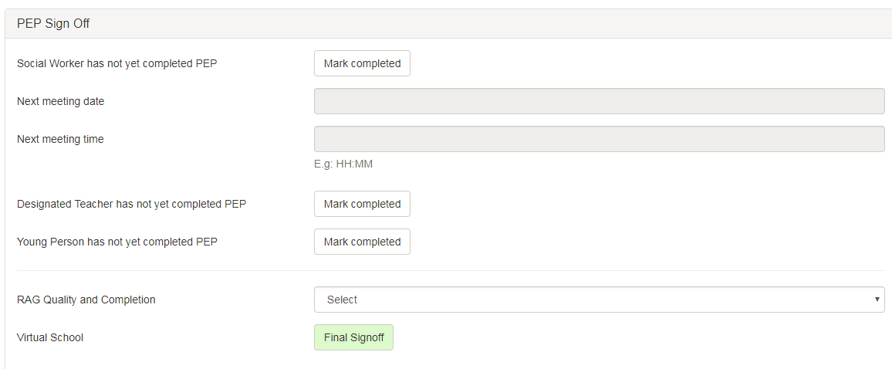
Sign off
Please remember to sign off your section.
The Designated Teacher is responsible for the PEP and the quality assurance of the Pupil Premium Plus.
Notes:
SAM

Slide 26
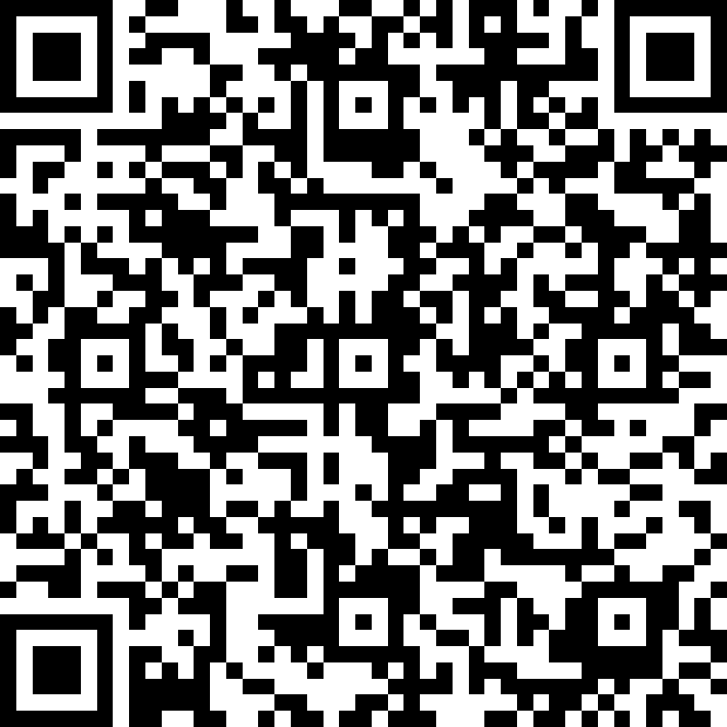
Please complete the evaluation form
Any questions
Any comments
Any support.
leonie.holt@camden.gov.uk EYS-Y2
lynn.burrows@camden.gov.uk Y3-Y7
samuel.denham@Camden.gov.uk Y8-Y11
mary.holder@camden.gov.uk Post 16
Evaluation form link: https://forms.office.com/r/fAbdgqZefy
Notes:
SAM

